Slide 1
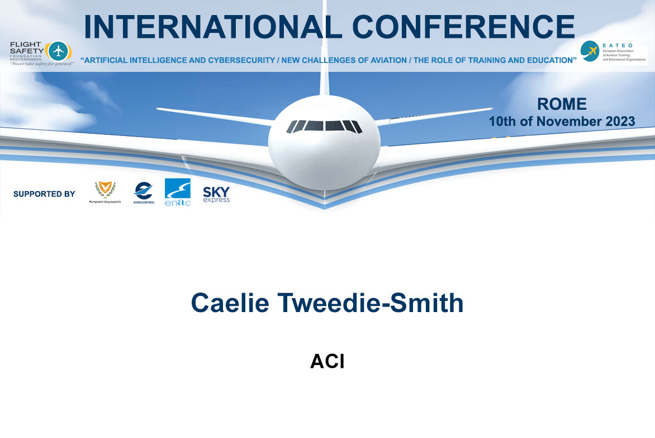

Slide 2


AI and Cybersecurity
New Challenges of Aviation
CAELIE TWEEDIE SMITH
MANAGER
LEARNING TECHNOLOGIES AND TRAINING PROGRAMS
ROME, 10 NOVEMBER 2023

Slide 3

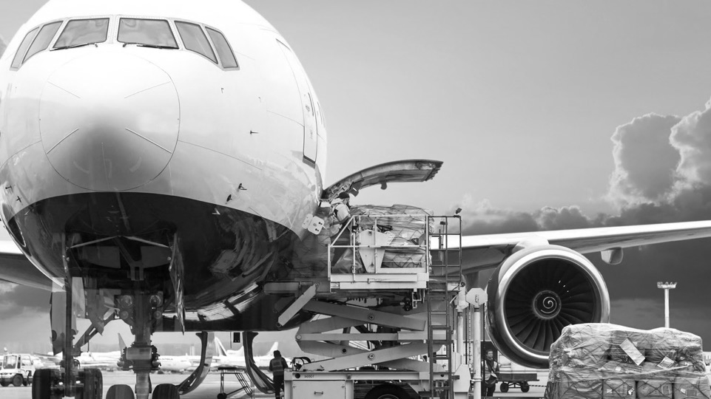
01
02
AGENDA
ACI INTRODUCTION
TRENDS FROM AIRPORT PERSPECTIVE
03
04
ACI ENGAGEMENT
TRAINING and EVENTS
3

Slide 4


The Voice of The
World’s Airports
OUR MISSION
ACI World contributes to the safety, security, and sustainability of the global aviation industry by advancing the collective interests of airports and the communities they serve and promoting excellence in airport management and operations.

Slide 5


ACI Federation
ACI World addresses
ACI
Global issues
ACI
Europe
North America
ACI
Brussels
Montreal
World
ACI
International regulatory bodies
Washington DC
Asia-Pacific
& Middle East
Casablanca
such as the International Civil Aviation Organization (ICAO)
Hong Kong
Panama City
ACI
ACI
Afica
Other organizations
Latin America and the Caribbean
with international interests
Each ACI Region addresses issues and regulatory bodies specific to that region.

Slide 6
Work with global partners
ACI World
collaborates with
International
organizations
Governments
Airport
members
Industry
stakeholders
Developing policies, programs, and best practices that
advance global airport interests and promote excellence in the aviation industry
Organizations we work with include:
ICAO
IATA
CANSO
ICCAIA
ATAG
International Civil
Aviation Organization
International Air Transport Association
Civil Air Navigation Services Organization
International Coordinating Council of Aerospace Industries Associations
Air Transport Action Group
WHO
WEF
WTTC
ITF
UNWTO
World Health Organization
World Economic Forum
World Travel and Tourism Council
International Transport Forum
World Tourism Organization
Notes:
Specific to IT and Security, mention the Standing Committees

Slide 7
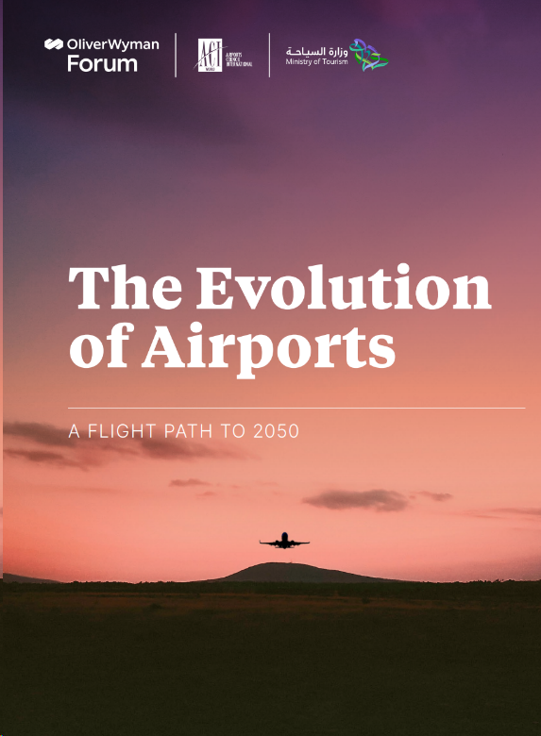


5 Mega Trends – future of airports
Achieving Net Zero
Technological Innovation
Intermodal Connectivity
The Changing Workforce
The Passenger Experience Revolution
Notes:
OliverWyman ACI Ministry of Tourism SaudiArabia The Evolution of Airports-A Flight Path to 2050 EN 2023.pdf
Apart from demographic change and evolving expectations of today’s workforce, as well as increasing focus on environmental sustainabililty, automation and digital transformation is already playing a pivotal role in the future of airports. Use of innovation, technology and digital transformation - airport apps, QR codes, scanning bar codes, touchless interactions at the airport have all been useful and make work more efficient. New jobs can be created as a result of innovation.
Such transformations open up other critical areas of concern, particularly in terms of cybersecurity and accessibility of data in the digital world.

Slide 8
ACI World Resolution # 4
“Affirming airport’s commitment to addressing the evolving cyber threats in aviation”
Agreed at the 33rd ACI World Annual General Assembly (WAGA) Barcelona, Spain, in June 2023.
Strengthen awareness
Risk assessment
Leverage international standards and frameworks
Support and develop aviation cybersecurity workforce
Also presented at ICAO AVSEC Week (October 2023)
Resolution # 4
ACI at ICAO AVSEC Week 2023
Notes:
https://aci.aero/wp-content/uploads/2023/06/WAGA_BCN_2023_Resolution_4_v3.pdf?_cldee=w4pg-hCzlhb-sOHJRWzyRz1gGGnhikjCHwnjIr3v6pbAP7aTpNDv5qRlXXgrVMD6&recipientid=contact-b111cb5fe673ec118943000d3ae8e8b1-6a51a5708b464682b7403c3666603c83&esid=229685b9-a66e-ee11-8179-0022483ddf55

Slide 9

APEX Cybersecurity Assessment
Key Benefits
Global Standards Alignment
In-depth Analysis & Control Evaluation
Risk Assessment & Vulnerability Identification
Functional Framework & Policy Review
Mitigate Cost Impact
Tailored to Airports
Notes:
ACI's peer-assessed excellence program designed to assist airports of all sizes in undertaking a comprehensive assessment of their cybersecurity landscape.
Launched at the recent
Key Benefits of APEX Cybersecurity Assessment:
Global Standards Alignment: Harmonize with established standards and frameworks.
In-depth Analysis & Control Evaluation: A holistic assessment of your airport's cyber ecosystem, across all aspects of operations.
Risk Assessment & Vulnerability Identification: Gain insights into risk management methodologies.
Functional Framework & Policy Review: Enhance existing security policies and procedures to meet industry standards.
Mitigate Cost Impact: Reduce potential significant costs resulting from major operational disruptions.
Tailored to Airports: Address unique aviation challenges with a program specifically crafted to foster security and resilience.

Slide 10
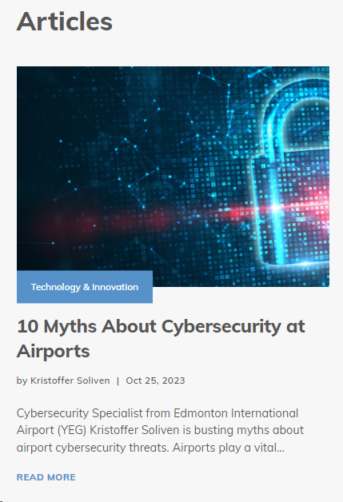
ACI World Airport IT Standing Committee (WAITSC)
Ensures airport interests are reflected in global policy development on airport IT, automation, telecommunications infrastructure, and passenger services
Purpose? Who are in this Committee? What do they do? What did they last discuss?
They develop handbooks and white papers, discuss and highlight priorities in the areas of:
Cybersecurity
AI
Digital transformation
Smart data
Notes:
https://blog.aci.aero/10-myths-about-cybersecurity-at-airports/
One of 6 standing committees that gives guidance to the ACI World Governing Board in terms of technical expertise and policy development to protect airport interests in the aviation exosystem.

Slide 11
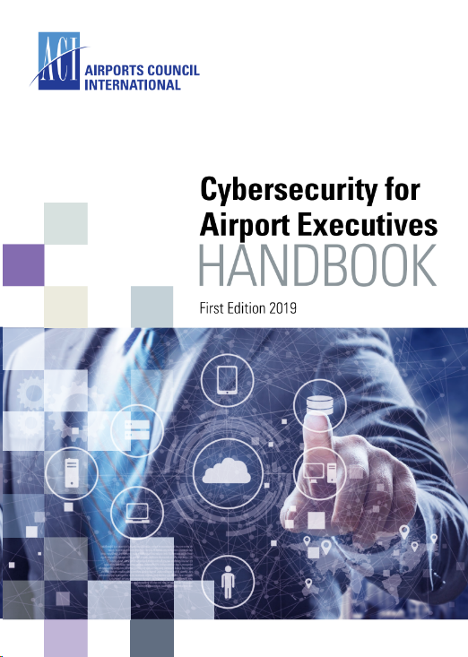
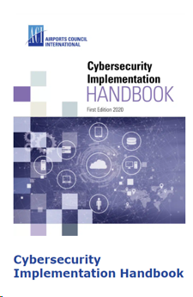
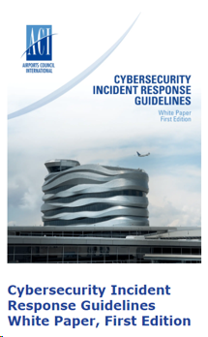
ACI Resources - Cybersecurity
Notes:
ACI World’s Cyber Security Implementation Handbook
- Airports Council International (ACI) World has published a new handbook to provide airports with guidance on how to establish a programme of cyber-resilience and maintain robust and efficient cyber-security defences.
- provides a comprehensive overview of the implementation of an all-inclusive security programme, complete with best practices and case examples, drawing on the experience of experts in both cyber-security and airport systems.
- The new resource provides airports with guidance on the best practices for establishing and implementing efficient cyber-security defences.

Slide 12
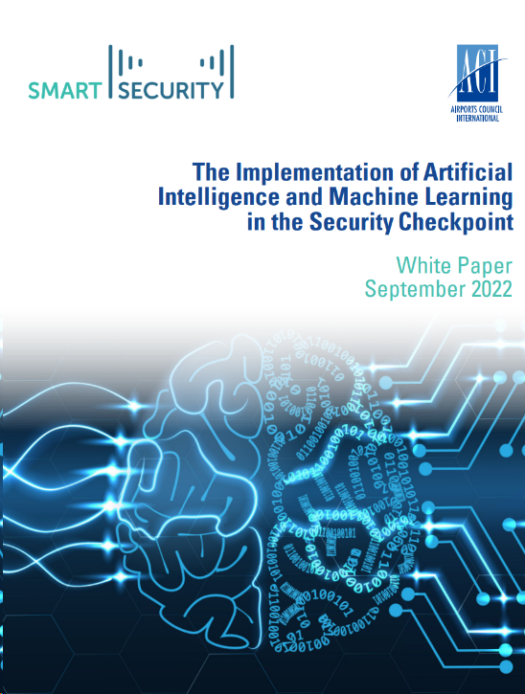
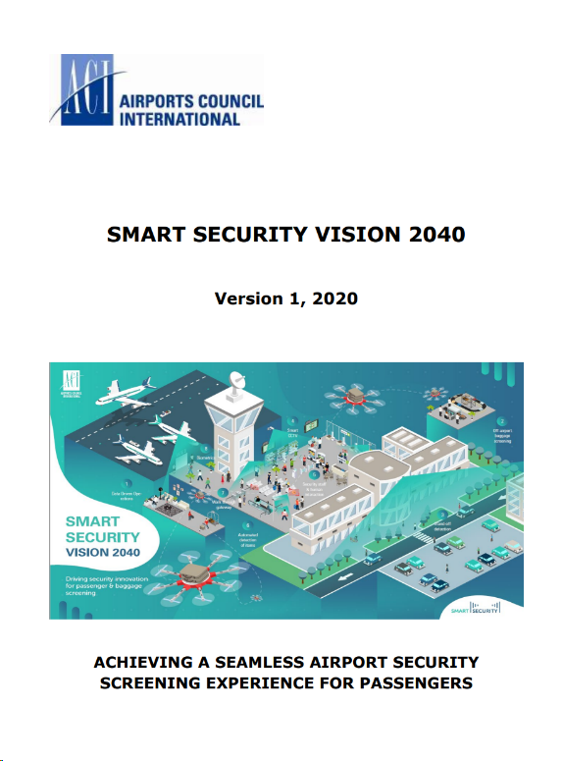
ACI Resources – Smart Security

Slide 13
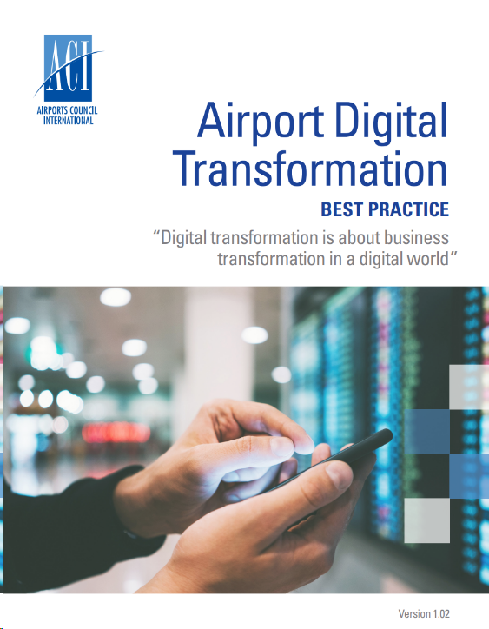
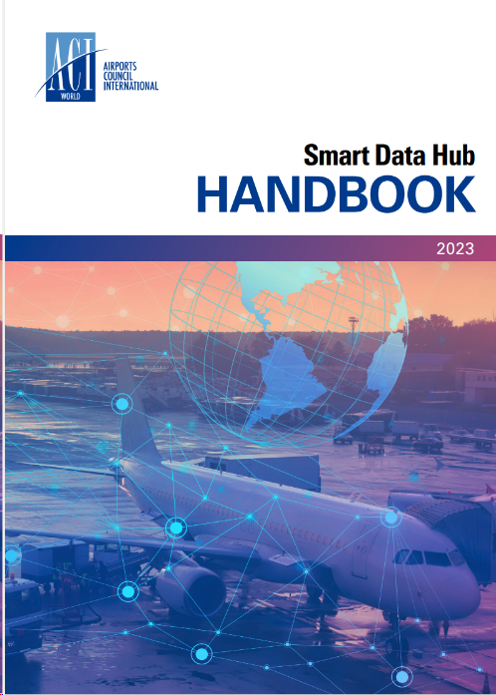
ACI Resources – Innovation and Technology
Notes:
The Smart Data Hub handbook represents a significant milestone in the journey towards optimizing the power of data in the aviation industry. This holistic resource provides a roadmap for the airport industry and its stakeholders to connect, share data and make informed decisions.
The key benefits of adopting a Smart Data Hub approach are as follows:
Enhanced Connectivity: The Smart Data Hub enables seamless data integration among all airport stakeholders, empowering them to collaborate and drive operational improvements.
Flexibility and Scalability: Designed to meet the evolving needs of airports, the Smart Data Hub is adaptable and scalable, ensuring its continued effectiveness as data requirements expand.
Actionable Insights: By leveraging the Smart Data Hub, airports can derive meaningful insights into airport performance and key drivers, enabling data-driven decision-making.
Data Maturity Assessment: The whitepaper includes a data maturity self-assessment tool, helping airports gauge their progress in becoming data pioneers and identifying areas for improvement.

Slide 14

GLOBAL TRAINING
Self paced online courses
Certificate in Airport Security
Certificate in Smart Security
Airport Digital Transformation
Onsite classroom courses
Management of Cybersecurity for Airport IT
Cybersecurity for Airport Managers

Slide 15
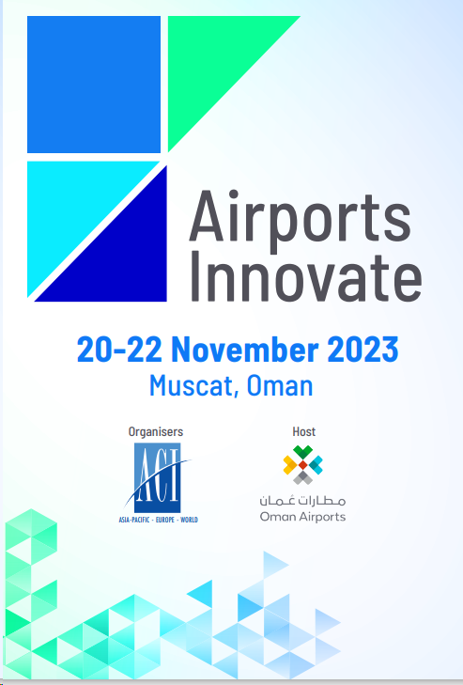

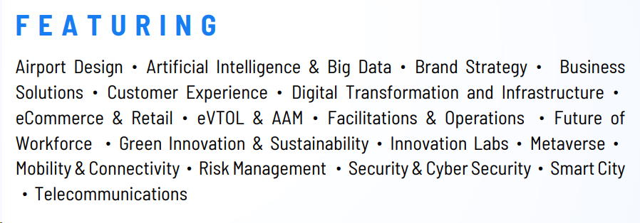
Airports Innovate 2023
Notes:
Join the creative and dynamic think tank reflecting the latest trends, original takes, and advancements in technology.
Airports are always striving to reinvent themselves in every aspect, ranging from operations to technology and business to strategy, and innovation is the driving force behind this transformation. In line with this dynamic environment, Airports Innovate is curated as premier global event that captures the remarkable innovations that is transforming the future of air travel.
Airports Innovate seeks out-of-the-box ideas by providing a platform for game-changers, innovators, start-ups and finest tech minds to demonstrate their disruptive ideas and solutions that have the potential to shape the future of airports.

Slide 16




Thank you
Airports Council International World
16

